Slide 1
Introduction to Web Technologies
Objects, Functions & Conditionals
Lecturer: Christen Cao

Slide 2
Content
Object, Function & Expression
Conditionals & Relation
Number Systems
Loops (for & while)

Slide 3
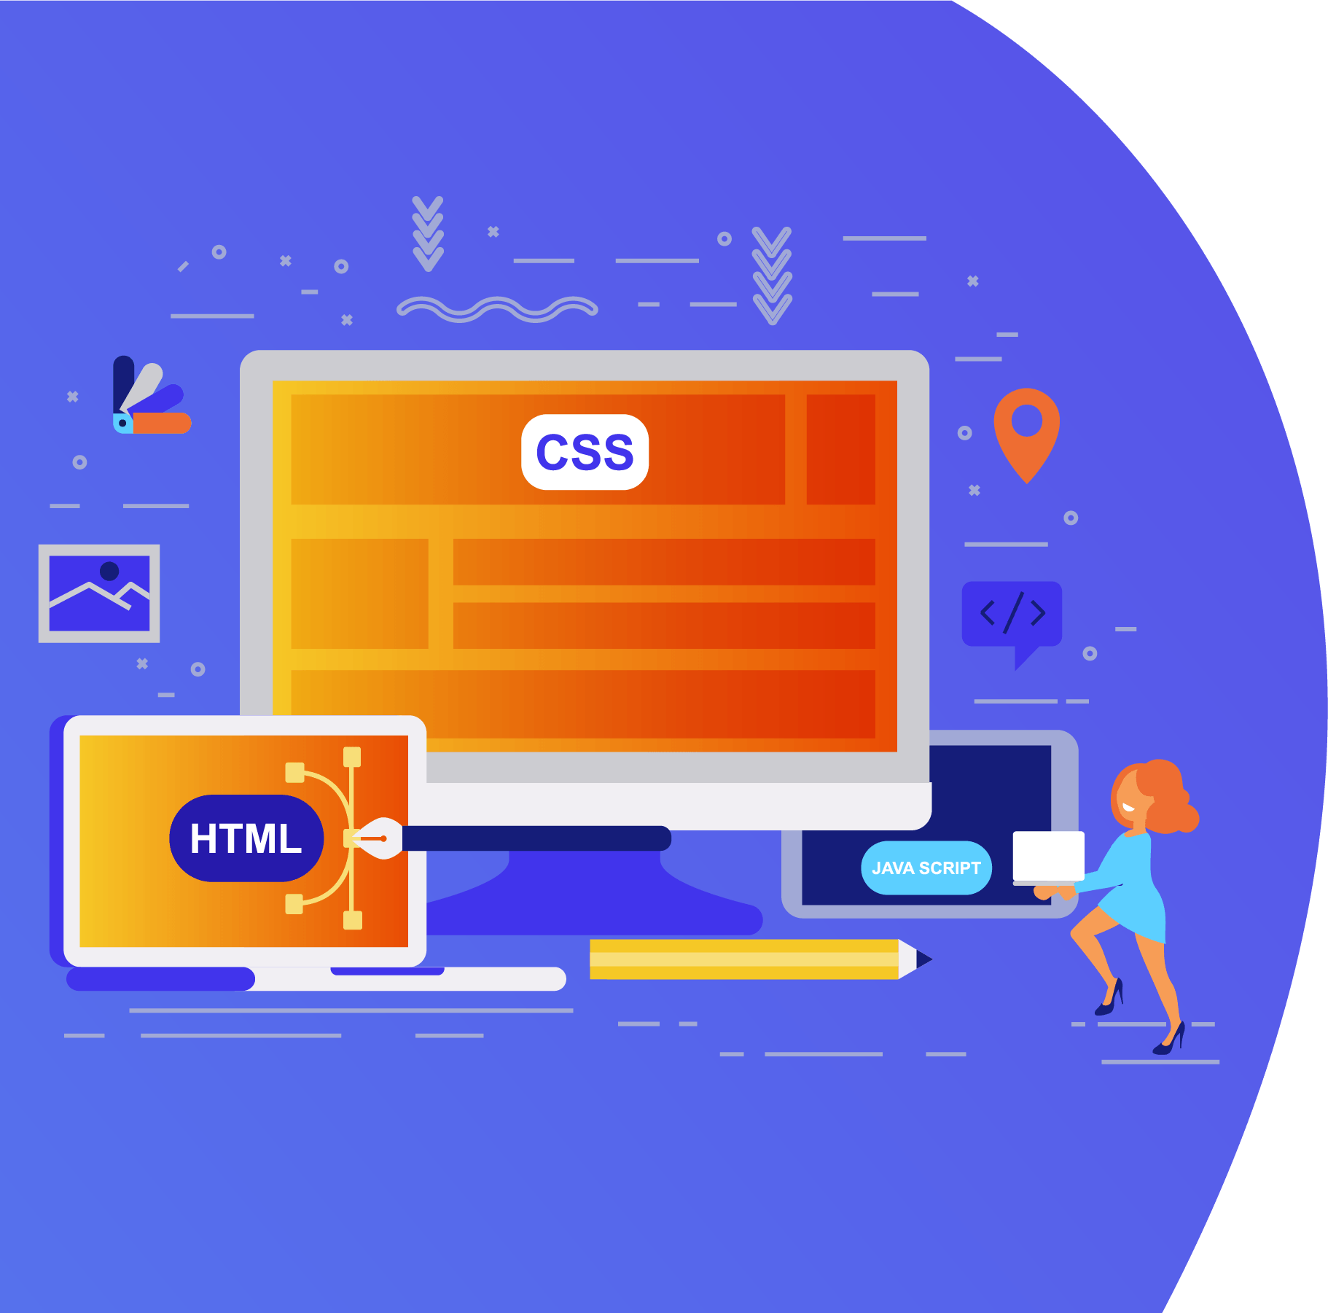
Topic 4.1: Object, Function & Expression

Slide 4
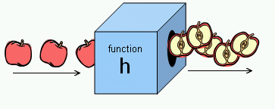
Functions and why?
identifier(parameter1, parameter2, …)
Function performs a specific task or procedure.
The task is to be carried out at multiple places for
multiple times
The task (procedure) is defined by experts and can be used by multiple people
Modularity: modular programming

Slide 5
Q&A: Object-oriented Programming (OOP)
Uses classes and objects to create models based
on the real-world environment.
Easy to maintain and modify existing code as new objects are created inheriting characteristics from existing ones
Easy to understand the program after development with well designed classes, objects and their methods and properties.
Efficiency: add new or destroy unused objects/classes easily
This course will only teach how to code functions in JS!

Slide 6
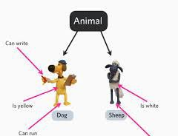
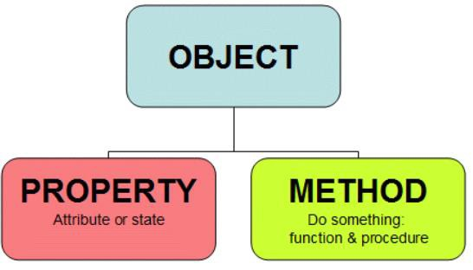
Q&A: Class/Object & JS
Class: a convenient way to abstract sets of objects with
common properties
"object" refers to a particular instance of a class
“object” can be containers of functions (methods), properties
(constants).
JS supports objects even without classes (OOP type)

Slide 7
Q&A: Procedure programming vs OOP
Procedure programming
Solving a problem from top of the code down to the
bottom
Statements start with strong verb
startCoffeeMachine(coffeemachineA);
washCoffeeMachine(coffeemachineB);
OOP
Solving a problem through objects
Statements start with the object to be manipulated
coffeemachineA.start(); coffeemachineB.wash();

Slide 8
Math.function( )
“Math” object: Container of math functions & constants.
Math.abs(x)
Math.sqrt(x)
Math.exp(x): E^{x}
Math.pow(x,n): x to the power n
Math.round(x), Math.ceil(x), Math.floor(x)
Math.max(...,...), Max.min(...,...)
Math.random() // [0,1)

Slide 9
Math.constant
Math.PI
returns PI, 3.14….
Math.SQRT2
returns 1.414…the square root of 2
Math.E
returns Euler's number 2.718…
It is just a value, so no brackets () are needed.

Slide 10
Expression
A legal combination of :
Value(s)
Variable(s)
Function call(s)
Operators
An expression represents a value
Used in a statement where a value is expected
Notes:
The values can be of various types, such as numbers and strings.

Slide 11
Expression Examples
For example, 5 * 10 evaluates to 50:
5*10 → 50
Expressions can also contain variable values:
var x;
x = 5;
x * 10 → 50
The values can be of various types, such as numbers and strings.
"John" + " " + "Doe” → "John Doe"
Notes:
→ : Evaluates to

Slide 12
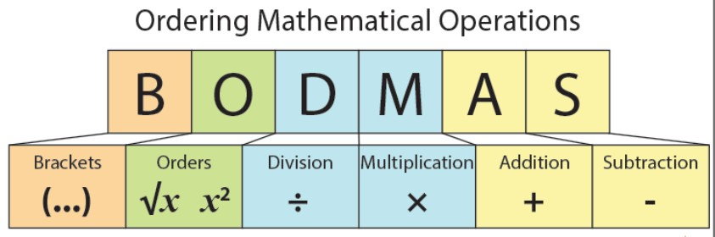
Evaluation Sequencing
Nested functions: inner functions/brackets first
Follows the precedence of the operators BODMAS
Use () when not sure

Slide 13
Try out : how does it work ?
If we enter 5:
alert(3+2+prompt(“Enter a number"));
alert(3+(2+prompt(" Enter a number")));
alert(3+Number(2+prompt(" Enter a number")));
Enter 5: 55
Enter 5: 325
Enter 5: 28

Slide 14
Topic 4.2: Conditionals & Relation

Slide 15
Conditions

Slide 16


Conditions: if (…)…;
Decisive Programs: Branching / Selection
Begin Statement
if ( )
if true – S tatement
End Statement

Slide 17
Conditions: if (…) … else …;
Decisive Programs: Branching / Selection
Begin Statement
if ( )
else
if true - Statement
if false - Statement
End Statement

Slide 18
if (…) {… ;} else {…;}
if ( test ) { do-this-statement; }
if(x >0 ) {alert(“a positive number.”);}
Alternatives:
If ( test ) {do-this-statement;}
else {do-the-other-statement; }
var x=15;
if (x>0) {
alert(“a positive number.”);}
else {
alert(“it is <=0”);}

Slide 19
Relational operators
Finding relationships between values:
what is the opposite operator to “x<0” ?
== equal
!= unequal
< less than
<= less than or equal
> greater than
>= greater than or equal

Slide 20
Try out: Relational operators
== equal
=== strict equal
!= unequal
!== strict unequal
< less than
<= less than or equal
> greater than
>= greater than or equal
Compare numbers, characters, or
strings
ASCII (American Standard Code for Information Interchange) here
var x = 2; alert(x==2); alert(x>=0); alert(x!=2);
var x = 'a';
alert(x=='a');
alert(x>='b');
alert(x!='p');
alert('abc' == 'abc');
alert('abd' >= 'abc');
alert('aba' >= 'abc');
alert('abc' > 'ab');
alert(3 > 'abc');
Notes:
ASCII is pronounced as as-key.

Slide 21

Is a letter before or after “a” in Ascii?
var c=prompt("enter a letter:");
if(c<'a’) {
alert( c + " is before 'a' in Ascii"); }
Else {
alert( c + " is after 'a' in Ascii"); }
Ascii table: space … 0-9 …. A-Z
… a-z

Slide 22
Topic 4.3: Number Systems

Slide 23
Number Systems
Integer number
An integer (more commonly called an int) is a number without a decimal point
-2, 0, 500, 1024, etc.
Float number
A float is a floating-point number, which means it is a number that has a decimal place. Floats are used when more precision is needed
4.0, 3.1415, 0.000001, etc.

Slide 24
Anything wrong ?
var x=2;
if(x==2)
{ alert("it is 2 " )} ;
else
alert("it is not 2");
{ alert("it is 2 " ) ;}
if(...) {stmt1; stmt2; ...stmtn;} if(...){...;...;} else {...;...;}
Notes:
Double equal, compare coming from the same variable
Triple equal, compare the value inside the variable
Must be triple equal!!

Slide 25
Topic 4.4: Loops

Slide 26
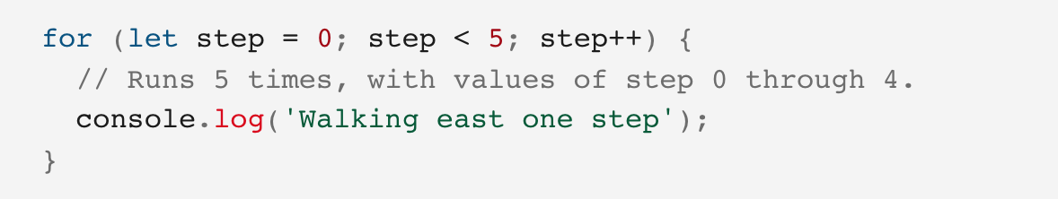
Loop (not tested, good to know)
Loops offer a quick and easy way to do something repeatedly.
Think of a loop as a computerized version of the game where you tell someone to take X steps in one direction, then Y steps in another.
For example, the idea "Go five steps to the east" could be expressed this way as a loop:
There are many different kinds of loops, but they all essentially do the same thing: they repeat an action some number of times. Here we’ll introduce for loop and while loop

Slide 27
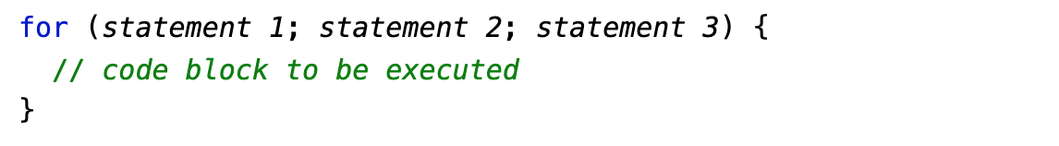
For loop
The for loop has the following syntax:
Statement 1 is executed (one time) before the execution of the code block.
Statement 2 defines the condition for executing the code block.
Statement 3 is executed (every time) after the code block has been executed.
Example:
for (let i = 0; i < 5; i++) { text += "The number is " + i + "<br>"; }
Notes:
From the example above, you can read:
Statement 1 sets a variable before the loop starts (let i = 0).
Statement 2 defines the condition for the loop to run (i must be less than 5).
Statement 3 increases a value (i++) each time the code block in the loop has been executed.

Slide 28
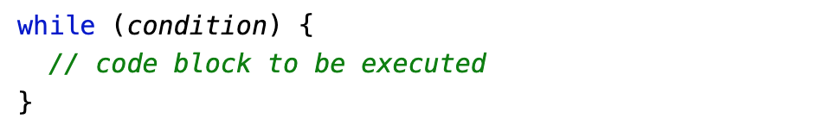
While loop
The while loop loops through a block of code as long as a specified condition is true.
Syntax:
Example:
var i = 0;
while (i < 10) { text += "The number is " + i; i++; }
Notes:
In the example, the code in the loop will run, over and over again, as long as a variable (i) is less than 10:

Slide 29
<Happy coding, everyone!/>
<Thank you!/>

